Slide 1
Taylor Community Consulting
Boy Scouts

Slide 2
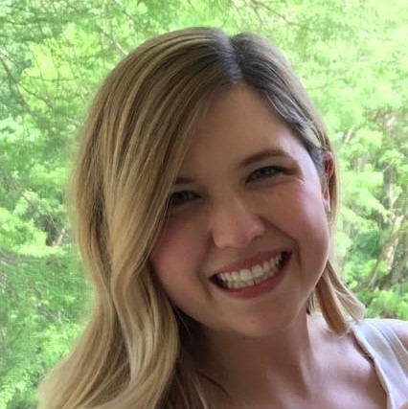



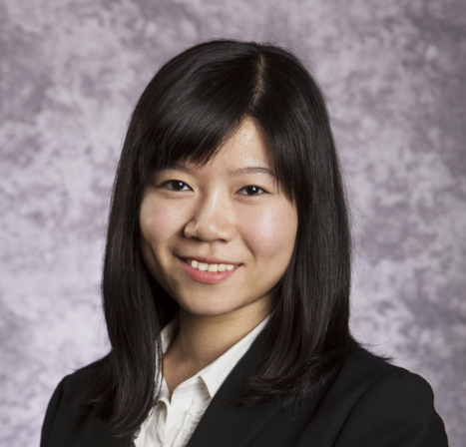
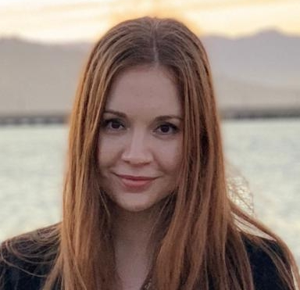

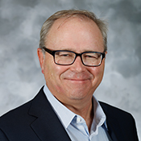
Our Team
Shannon Hitzler
MBA
shannon.hitzler@wustl.edu
Zhijie Huang
MS Business Analytics
zhijie.huang@wustl.edu
Dominique Nie
MS Business Analytics
congnie@wustl.edu
Jack Zhang
Ph.D Candidate, Organizational Behavior
zhangjack@wustl.edu
Cindy Chou
MS Supply Chain
cindychou@wustl.edu
Adriana Magda
MBA
adrianamagda@wustl.edu
Mahendra R. Gupta
Former Dean and Geraldine J. and Robert L. Virgil Professor of Accounting and Management
m.gupta@wustl.edu
William P. Bottom
Joyce and Howard Wood Distinguished Professor of Organizational Behavior
bottomb@wustl.edu

Slide 3
Agenda
Introduction
Approach
Key Impact Areas
Findings & Insights
Recommendations
Limitations
Appendix

Slide 4
Introduction

Slide 5
Boy Scouts Mission
Scouting is adventure, family, fun, character, leadership and so much more.¹
The Greater St. Louis Area Council, Boy Scouts of America, provides educational programs that build character, teach participatory citizenship and develop personal fitness²
Source:1. https://www.scouting.org/
2. https://stlbsa.org/

Slide 6

Project Goals
Overarching Goal: Develop a way to assess the long-term impact of participation in the Boy Scouts, focused on St. Louis Chapter
Project Goal: Develop a framework that measures the impact of Boy Scouts participation that will be leveraged in a subsequent study
Immediate Goals: Run a pilot study using the above framework, identify key learnings and make recommendation to improve the framework for the full study
Secondary Goals: Get an idea of the results the full study may get
Stakeholders: Donors (e.g. United Way), Board of Directors, Management, Parents, Community

Slide 7
Approach

Slide 8
Approach
1. Identify key impact areas​​
2. Get stakeholder input (management, board)​
3. Develop framework of impact study​​
4. Create pilot survey​​
5. Run pilot​​
6. Analyze pilot data ​
7. Create report​​
8. Final presentation

Slide 9

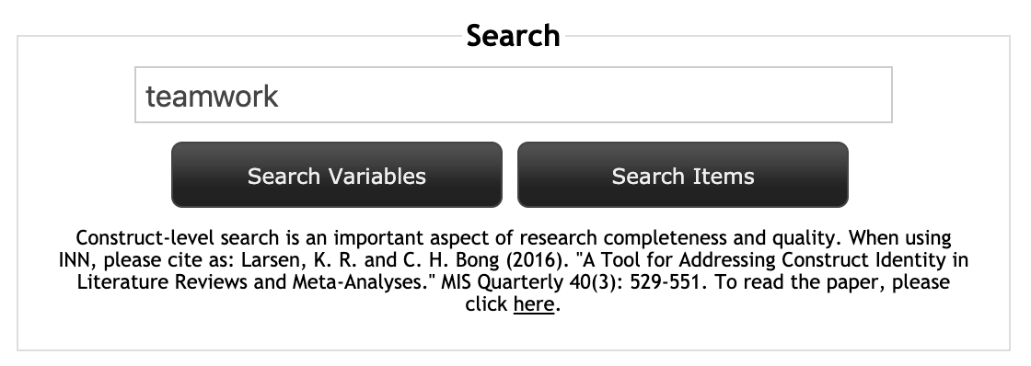
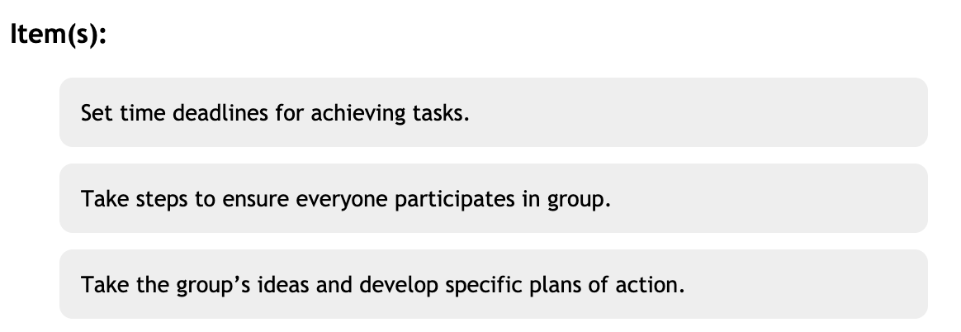
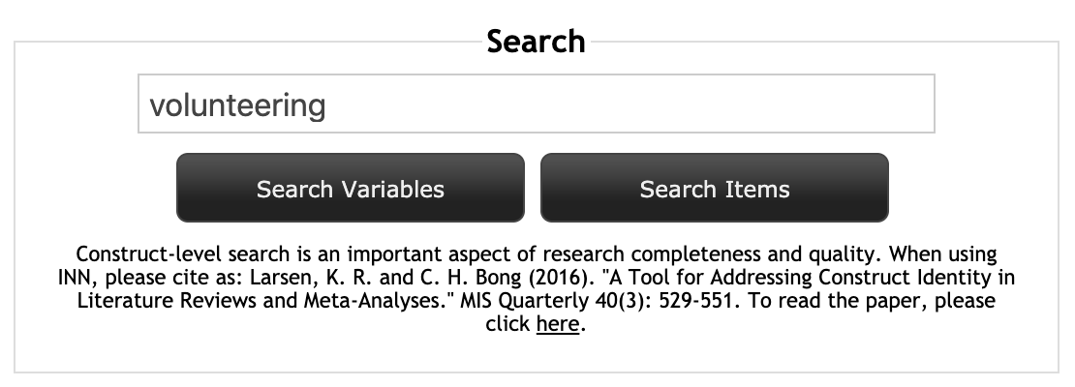
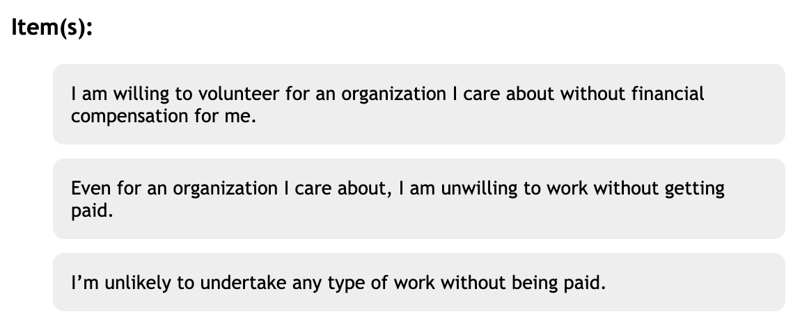
Research validated survey questions

Slide 10
Approach – Survey Structure
Demographic
Key Impact Area 1
Key Impact Area 2
Key Impact Area 3
Key Impact Area 4
Boy Scouts Experience
Multiple Choice Questions
Rating Scale Questions
Likert Scale Questions
Matrix Questions

Slide 11
Impact Areas

Slide 12
Four Key Impact Areas
Character Development
Leadership
Citizenship
Fitness
Self-confidence
Ethical behavior/integrity
Teamwork
Willingness to take leadership role
Public speaking
Goals/life plan
Volunteering
Patriotism
Financial responsibility
Donating
Physical
Exercise habits
Mental
Mental health

Slide 13
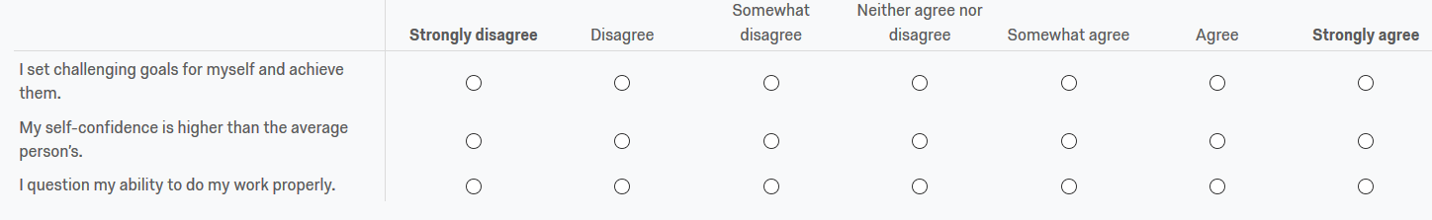
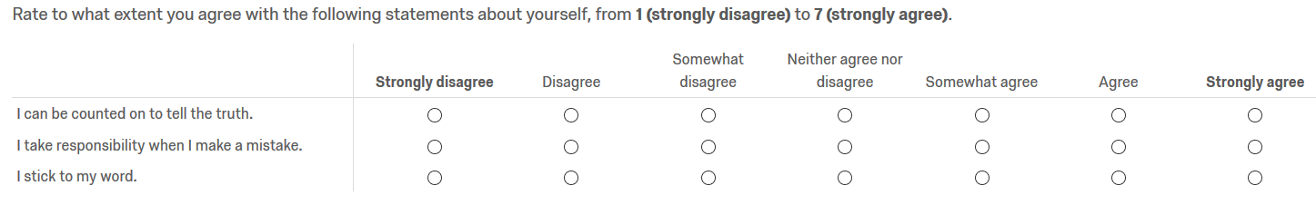
Sample Questions – Character Development
Self-confidence
Ethical behavior

Slide 14
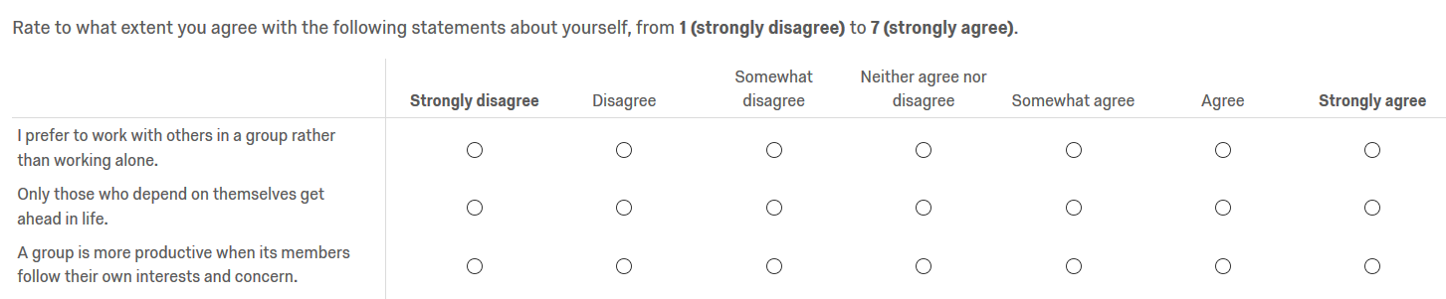
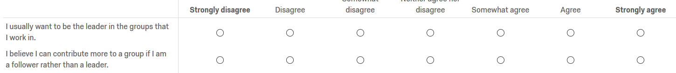
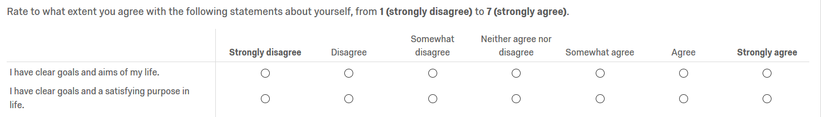
Sample Questions - Leadership
Teamwork
Willingness to take leadership role
Goals/life plan

Slide 15
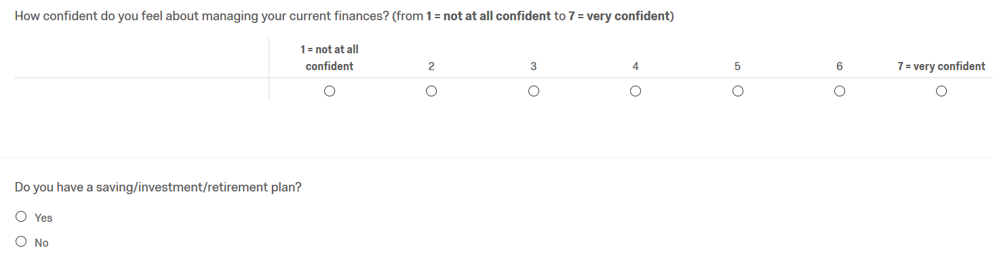
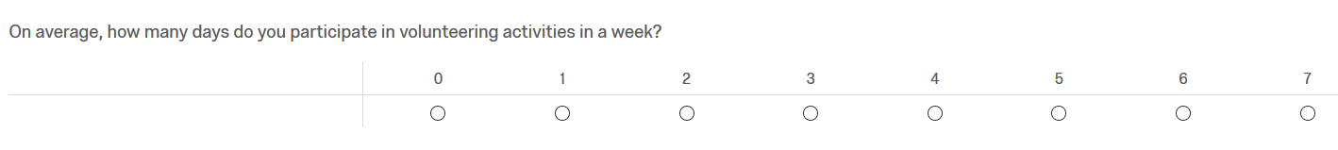
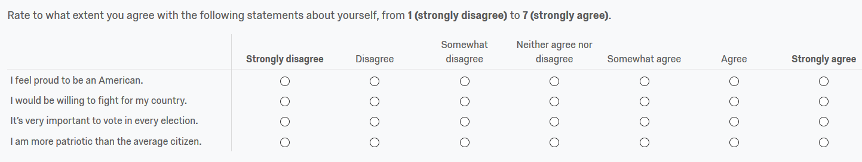
Sample Questions – Citizenship
Financial Responsibility
Volunteering
Patriotism

Slide 16
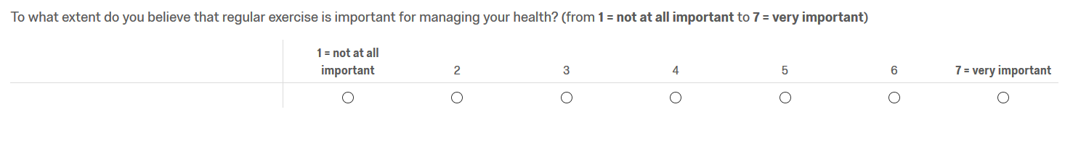
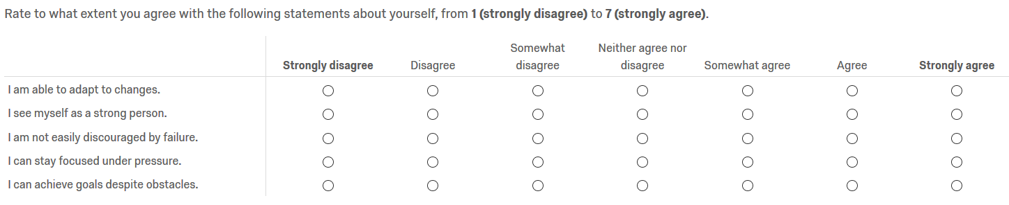
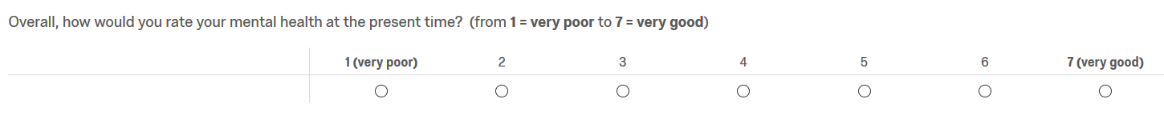
Sample Questions – Fitness
Physical Fitness
Mental Health

Slide 17
Findings & Insights

Slide 18
Summary Statistics
100 out of 110 are valid questionaires
Average took 11.38 minutes to finish the survey
55% of respondents are Boy Scouts Alumni
Average years of respondent were a Boy Scouts member before 18 year old: 6.85 years

Slide 19
Boy Scouts Participation
Nearly 40% of Scouts Alumni report that participation in the Boy Scouts had been important or very important in their lives.
Boy Scouts (ages 11-17)
Cub Scouts (ages 5-10)
Cub Scouts (ages 5-10), Boy Scouts (ages 11-17)
Cub Scouts (ages 5-10), Boy Scouts (ages 11-17), Venturing (ages 14-21)
Cub Scouts (ages 5-10), Venturing (ages 14-21)
Venturing (ages 14-21)
Achieved Eagle Scout Rank
9.5%
28.6%
49.2%
7.9%
1.6%
3.2%
30.2%

Slide 20
Educational Attainment
62.9% of Scouts Alumni have a Bachelor’s degree, almost 2.1 times or 108% higher than the US national average*
25.8% of Scouts Alumni have a Graduate’s degree, almost 2 times or 100% higher than the US national average†
*Source: Statistical Atlas, https://statisticalatlas.com/United-States/Educational-Attainment
† Source: Census Reporter, https://censusreporter.org/data/table/?table=B15002&primary_geo_id
=31000US41180&geo_ids=31000US41180,04000US17,33000US476,01000US

Slide 21
Income Distribution
Reported individual income higher than $75k
46% of Scouts Alumni
28% of the Non Scouts
St Louis Median Income: $62.2k*
US Median Income: $61.9k*
*Source: United States Census Bureau, https://data.census.gov/cedsci/table?q=S19&d=ACS%201-Year%20Estimates%20Subject%20Tables&g=&table=S1901&tid=ACSST1Y2018.S1901&lastDisplayedRow=16

Slide 22
Finances
Scouts Alumni | Non Scouts
73% | 59.3%
78.3% | 52.8%
85% | 75.5%
65% | 65%
Credit Score higher than US average*
Confident or very confident about managing finances
Has a retirement/investment plan
Didn’t take student loans or paid student loans within 10 years
*Credit Score Distribution and US average in appendix

Slide 23
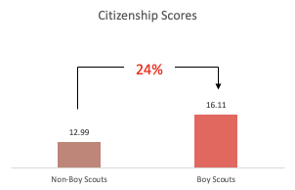
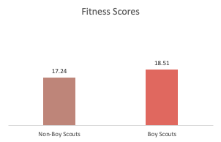
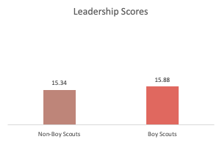
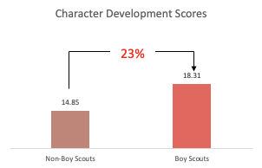
Comparison between Scouts and Non-Scouts: Overview
Non-Boy Scouts
Boy Scouts
60.43 points
68.81 points
14%
Notes: The total points are 100, with each key impact area contributes 25 points equally.
Notes:
Ex. 17/25 points
Slide to explain how we got to these scores

Slide 24
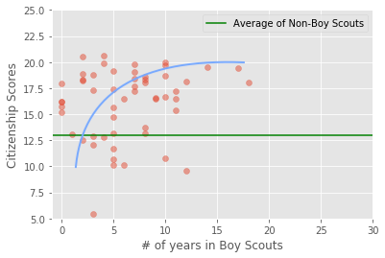
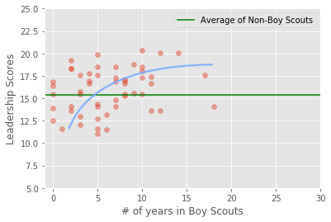
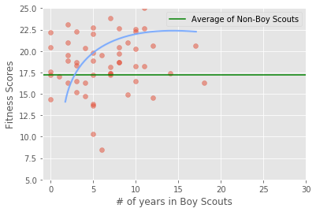
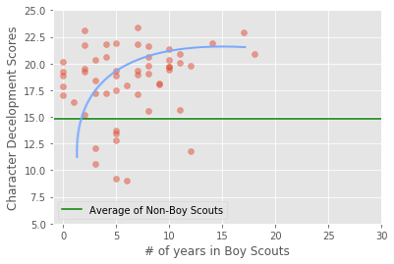
Years of Membership & Key Impact Scores
Notes:
What do the colors mean?

Slide 25
Comparison among different programs: Citizenship
Citizenship Scores (25 in total)
Scouts group | Non-scouts group
16.11 | 12.99
c
Venturing program participants achieved highest Citizenship score among all three Scouts programs
Citizenship Score
17.14
Higher than Scouts average
6.39%

Slide 26
Comparison among different programs: Leadership
Leadership Scores (25 in total)
Scouts group | Non-scouts group
15.88 | 15.34
c
Venturing program participants achieved highest Leadership score among all three Scouts programs
Leadership Score
16.31
Higher than Scouts average
2.71%

Slide 27
Comparison among different programs: Character Development
Comparison among different programs:
Character Development Scores (25 in total)
Scouts group | Non-scouts group
18.31 | 14.85
c
Venturing program participants achieved highest Character Development score among all three Scouts programs
Character Development Score
19.74
Higher than Scouts average
7.81%

Slide 28
Comparison among different programs: Fitness/Wellbeing
Comparison among different programs:
Fitness/Wellbeing Scores (25 in total)
Scouts group | Non-scouts group
18.51 | 17.24
c
Venturing program participants achieved highest Fitness/Wellbeing score among all three Scouts programs
Fitness/Wellbeing Score
19.17
Higher than Scouts average
3.57%

Slide 29
Comparison among different programs: Total Impact
Comparison among different programs:
Total Impact Scores (100 in total)
Scouts group | Non-scouts group
68.81 | 60.43
c
Venturing program participants achieved highest Total Impact score among all three Scouts programs
Total Impact Score
72.36
Higher than Scouts average
5.16%

Slide 30
Learnings - Summary of respondent verbatim feedback
Be specific when asking about Boy Scout membership, about youth participation in Boy Scouts or general participation (e.g. as adult volunteer)
Add back button, some people were confused in the first question (see above) and couldn’t change their answer
Include choices for adult members/include volunteering activities or adult leadership roles in questions regarding participation in the Boy Scouts
Question regarding job role/position should include an “Other” option
Consider age range of respondents - some of the demographic information around career doesn’t apply to retirees

Slide 31
Recommendations

Slide 32




Recommendations
Quantify key insights: economic & social impact
Refine survey questions/
Expand areas of interest
Deploy 2nd survey to
broader sample
Create key stakeholder selling story/key RTBs

Slide 33
Limitations

Slide 34

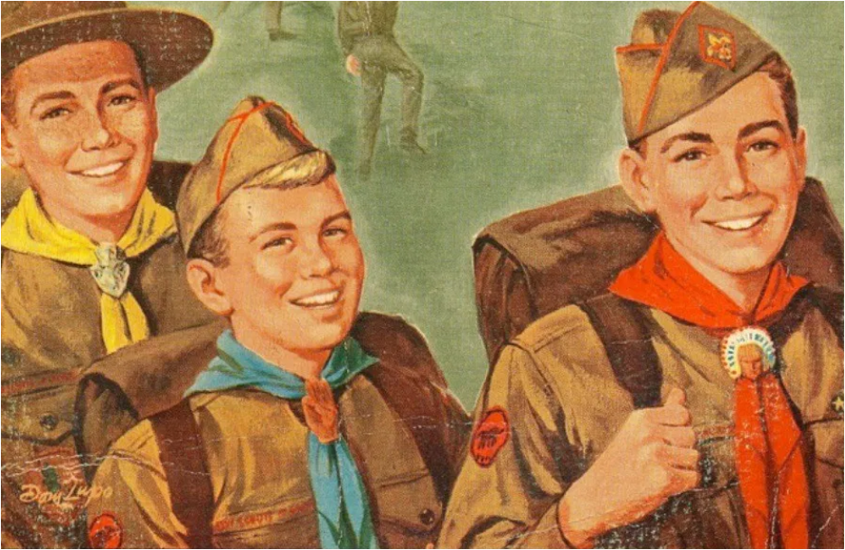
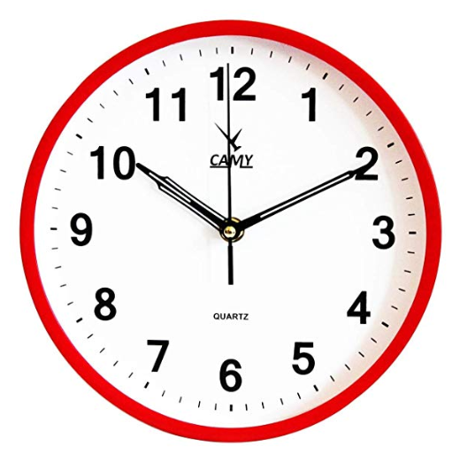

Limitations
MEN ONLY
VOLUNTEER BIAS
TIME CONSTRAINTS
SMALL SAMPLE SIZE

Slide 35
Appendix

Slide 36
Additional Respondent Demographics
Gender | Scouts Alumni | Non Scouts
Female | 14.5% | 55.4%
Male | 85.5% | 42.9%
Prefer not to say | 0.0% | 1.8%
Childhood Family Income | Scouts Alumni | Non Scouts
Low Income | 8.1% | 5.4%
Low-middle Income | 35.5% | 33.9%
Middle Income | 33.9% | 50.0%
Upper Income | 0.0% | 3.6%
Upper-middle Income | 22.6% | 7.1%
Age | Scouts Alumni | Non Scouts
18-29 | 9.7% | 19.6%
30-44 | 46.8% | 44.6%
45-59 | 29.0% | 30.4%
60-74 | 14.5% | 5.4%
Job title | Scouts Alumni | Non-Scouts
Manager or above | 47.5% | 40.0%
Race | Scouts Alumni | Non Scouts
American Indian or Alaska Native | 0.0% | 1.8%
Asian | 1.6% | 5.4%
Black or African American | 4.8% | 8.9%
Two or more races | 4.8% | 0.0%
White | 87.1% | 83.9%
Hispanic | 1.6% | 0.0%
Survey respondents work in 30+ different fields

Slide 37
Finances
US Average Credit Score: 703
https://www.experian.com/blogs/ask-experian/what-is-the-average-credit-score-in-the-u-s/

Slide 38
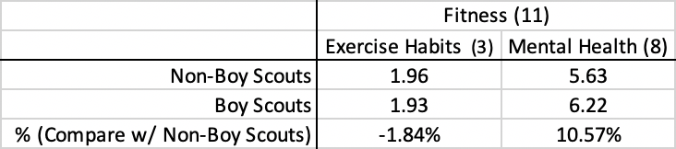

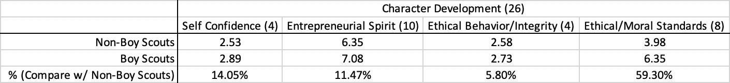
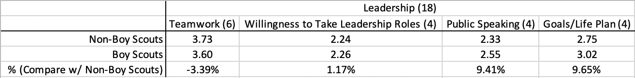
Appendix
Number in the parenthesis represents the number of questions of that topic.How to interpret the score? For example,there are 5 questions under financial respoinsibilities, so the total scores are 5 points and boy scouts got 2.66. There are 4 questions under patriotism and boy scouts got 3.07 over 4. Compared with non-boy scouts, boy scouts has a 23% increase in patriotism.

Slide 39
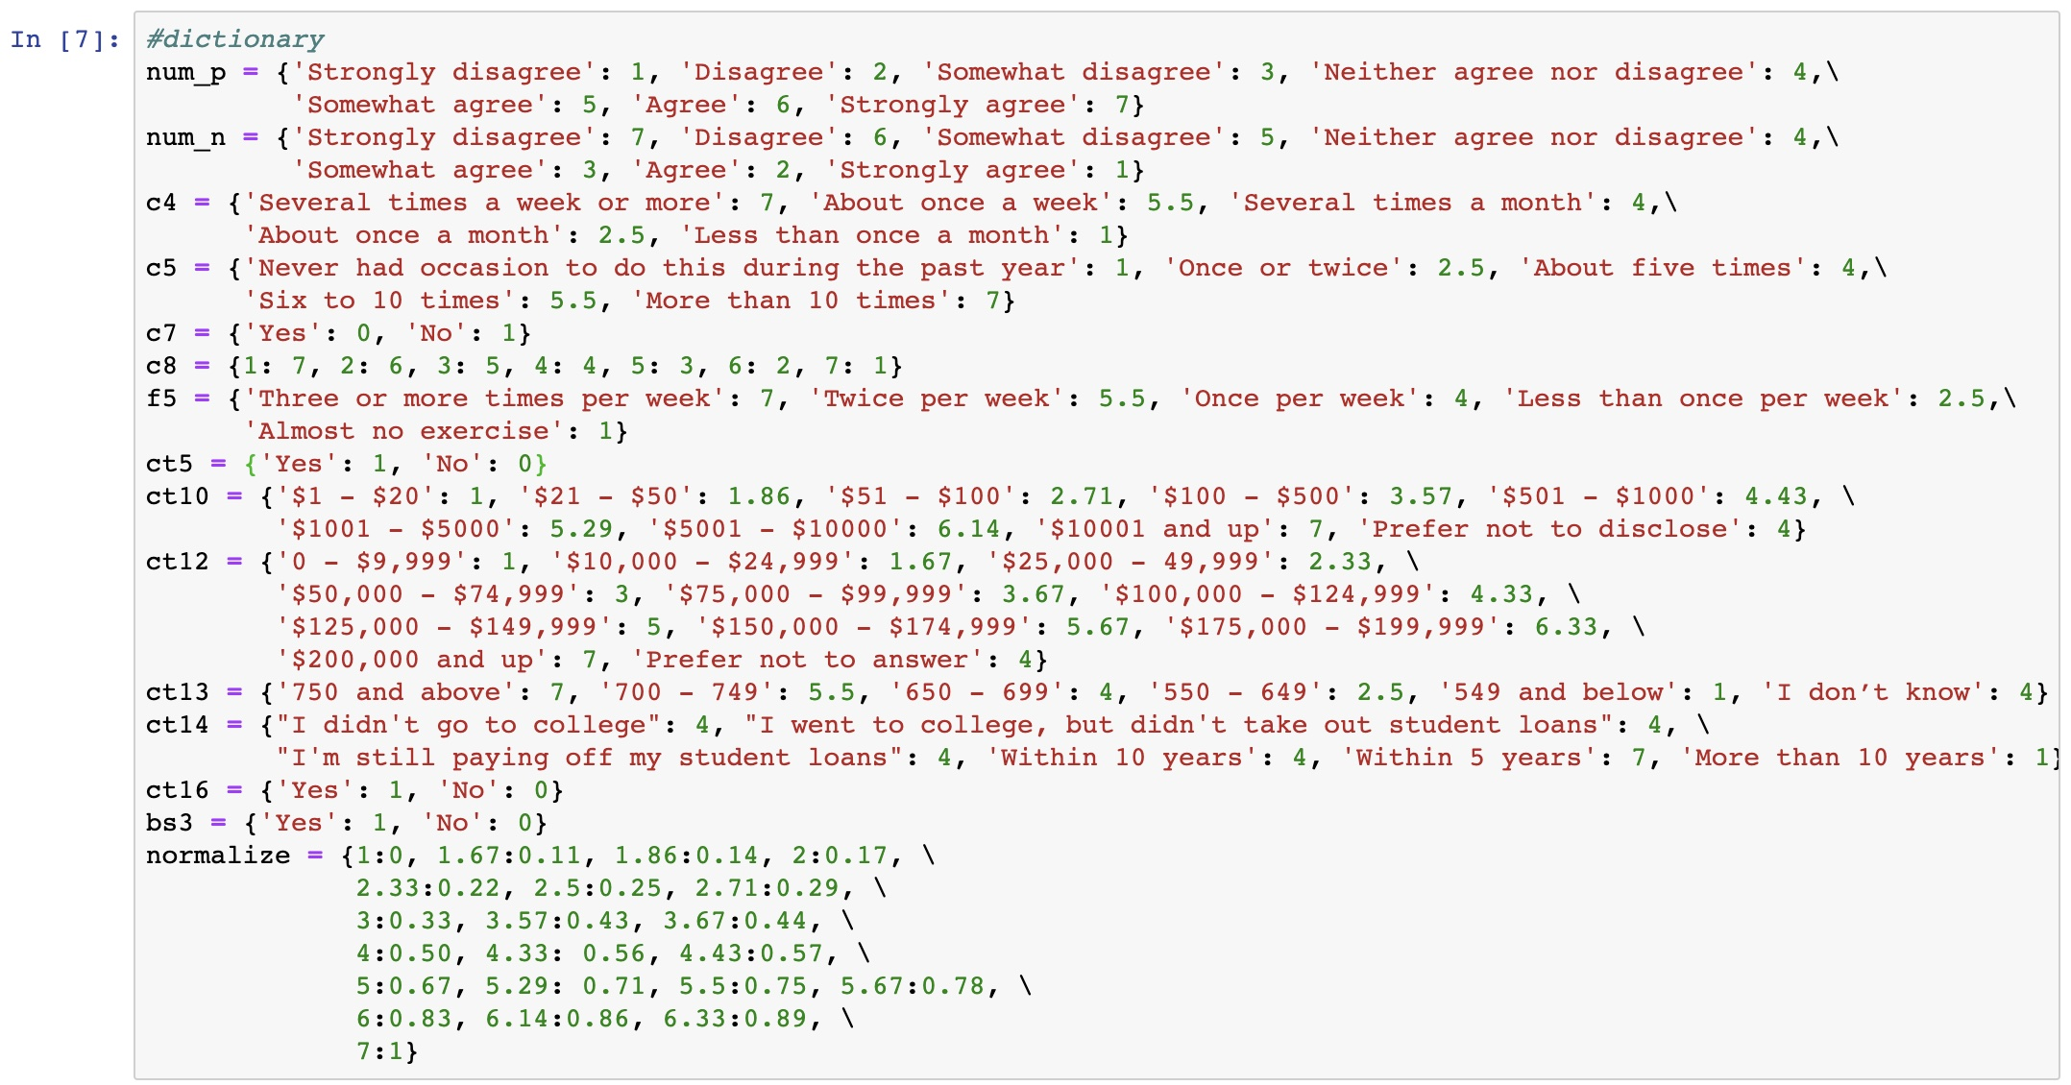
Appendix: Data Categorization

Slide 40
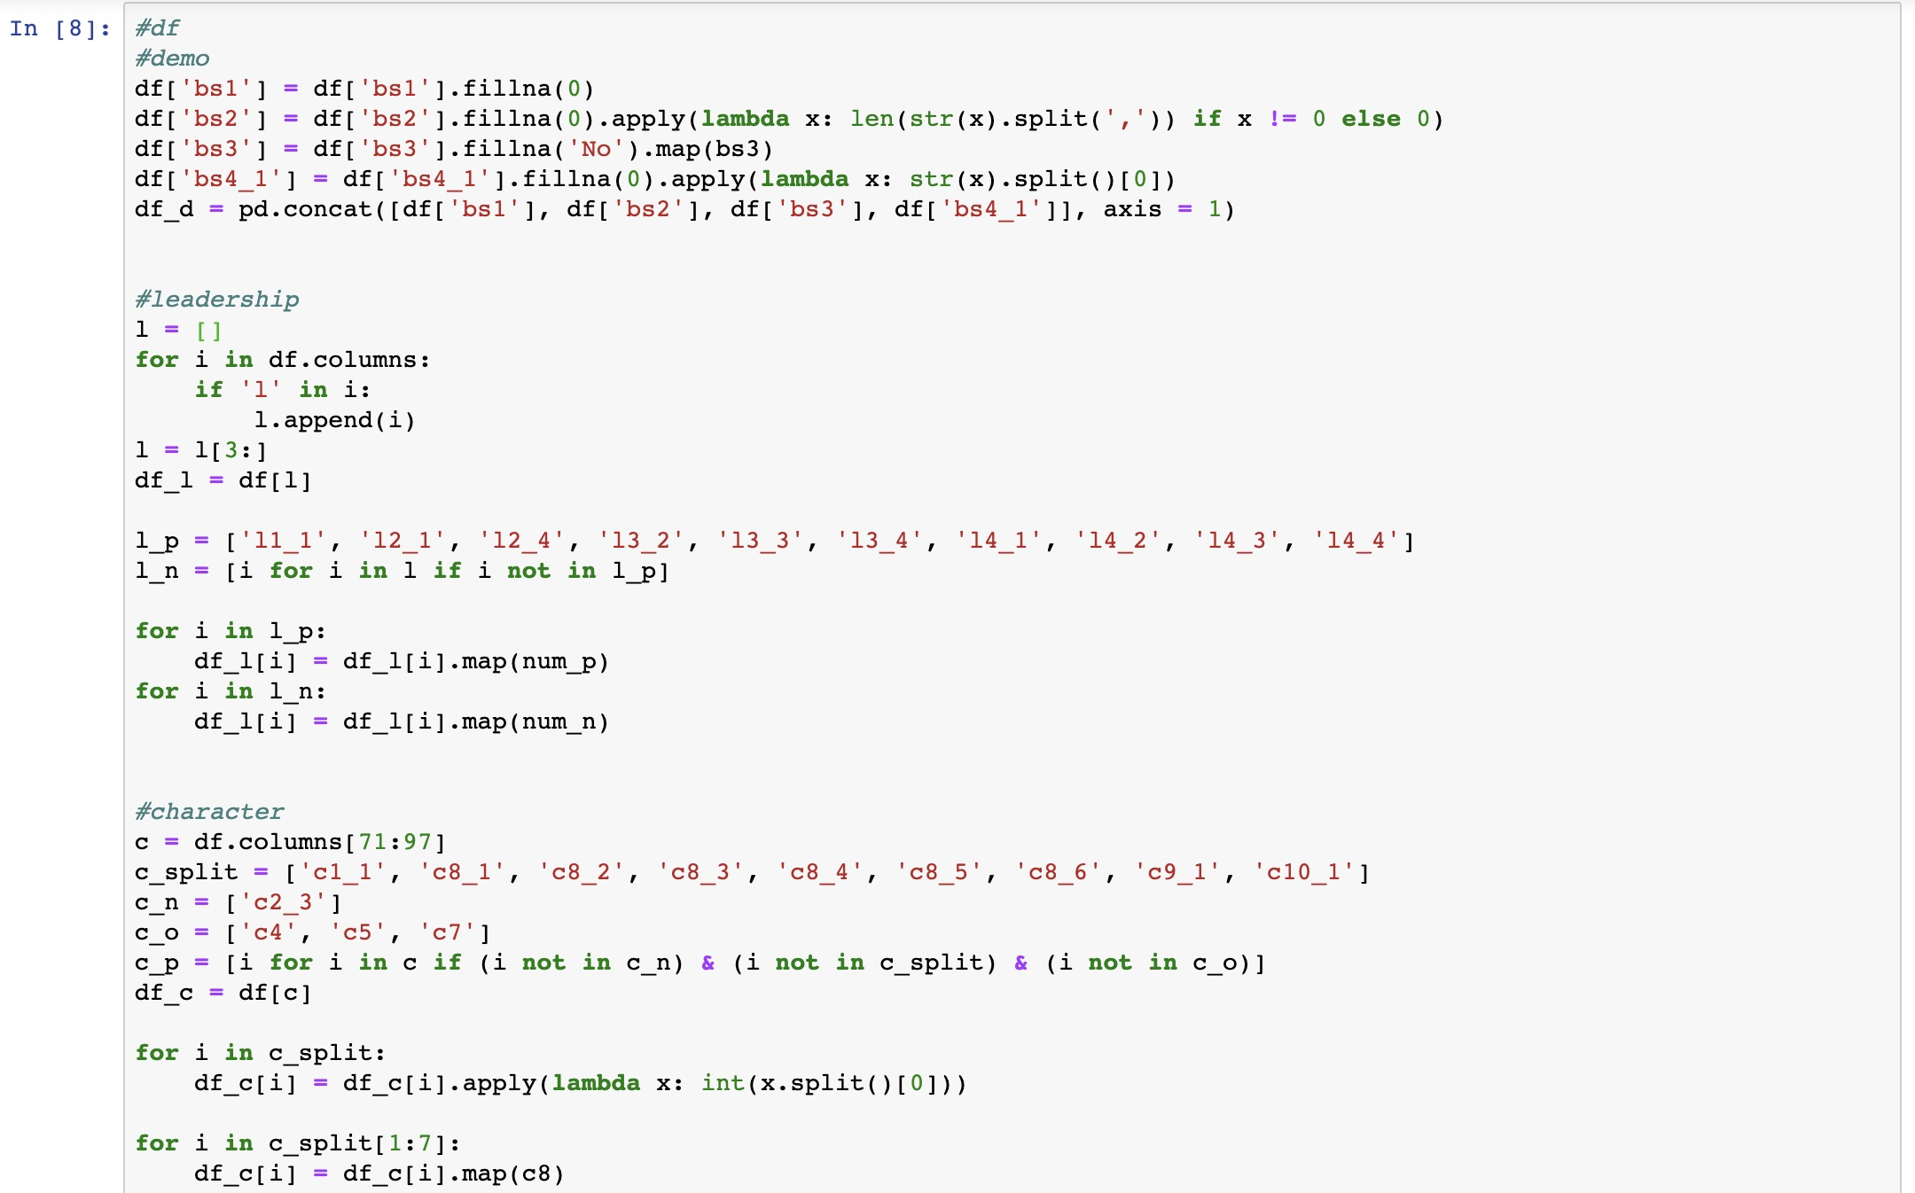
Appendix: Data Processing

Slide 41
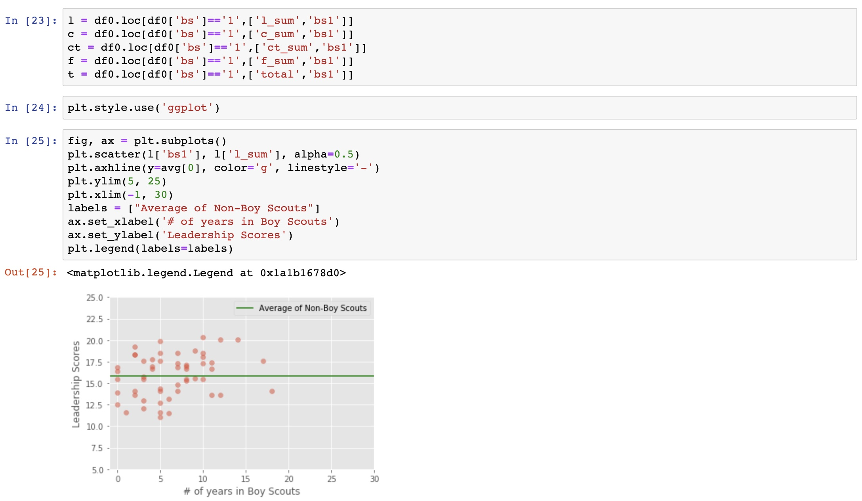
Appendix: Clustering

Slide 42
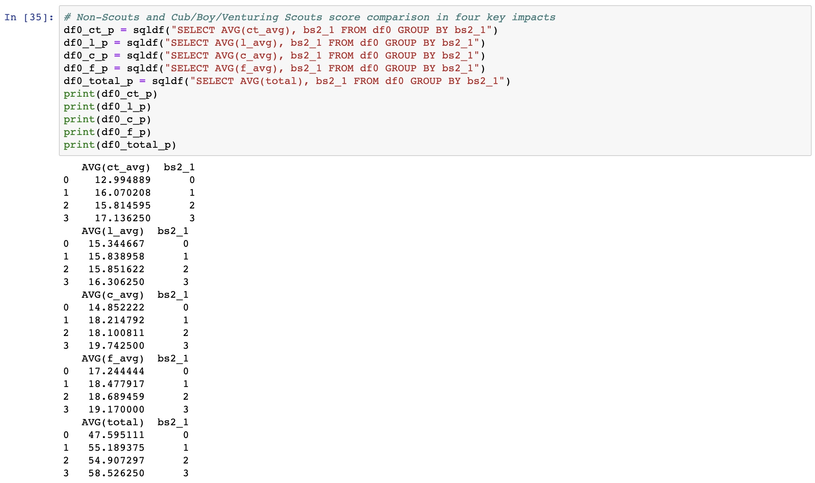
Appendix: Data Analysis

